Slide 1
Machine Learning Task:
Predicting avocado prices and volumes
Shweta Tiwari
email: shwetatiwari2601@gmail.com

Slide 2
Avocado-king’s problem
Avocado King sells conventional and organic avocados all over the US
What Avacado King knows: What Avacado King does not know:
Weekly dates of measurement
Average prices of avocados sold
Average volumes (8 different types information about it) of avocados sold
Geographical locations of sales in the US
Type of avacados sold: conventional and organic
Google search data of relative number of searches performed in the U.S for “avocado …” on Google
How to maximize profit from selling avocados by taking informed decisions about price and volume to be sold (maybe also about geographical locations where to sell)

Slide 3
How we can help the Avacado King
We can analyze the given data and build machine learning based predictive models to help AK take profit making decisions on avocados sales.
Questions?
-Correlations
- trends
-any other insights
- ML models

Slide 4
Library used in the task
I used python programming language for the task
For data analysis I used pandas library
For visualization I used matplotlib and seaborn
For machine learning models I use scikit-learn
For time-series analysis I used facebook’s Prophet

Slide 5
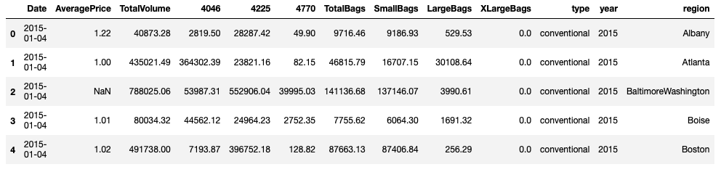
Avocados sales data
The data is from 04-01-2015 to 14-07-2019.
Data represents weekly avocado price and volume
The dataset contains 25161 rows and 13 columns. Where we have following features:
Categorical features: type (2) and region (54)
Numerical features: TotalVolume, 4046, 4225, 4770, TotalBags, SmallBags, LargeBags, XLargeBags and year
Date feature: Date
Target: AveragePrice

Slide 6
Exploratory Data Analysis (EDA)
Two sets of data (price-and-sales-data.csv, google-data.csv) so it is directly read to the jupyter notebook using pandas Python library
It is important to first clean the data, remove outliers and handle the null values in the dataset, before training any prediction model
Read Data
Handle missing/null values
Encoding categorical features
Feature correlation/Engineering

Slide 7
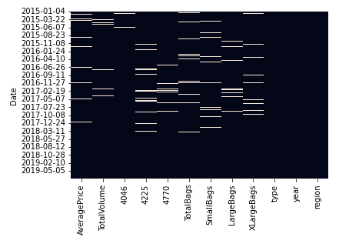
Missing Values
In the figure we can see that there are some null values in the data (grey area).
We can handle these null values by removing them.
If there are missing values in the dataset, we can fix them by imputation methods.
In the data I observed few weeks data is missing in December 2019. However, I ignored it as of now.
In my analysis, I removed null values
I also drop columns with ’type’=TotalUS
In the end we get data of shape = (18043, 13)

Slide 8
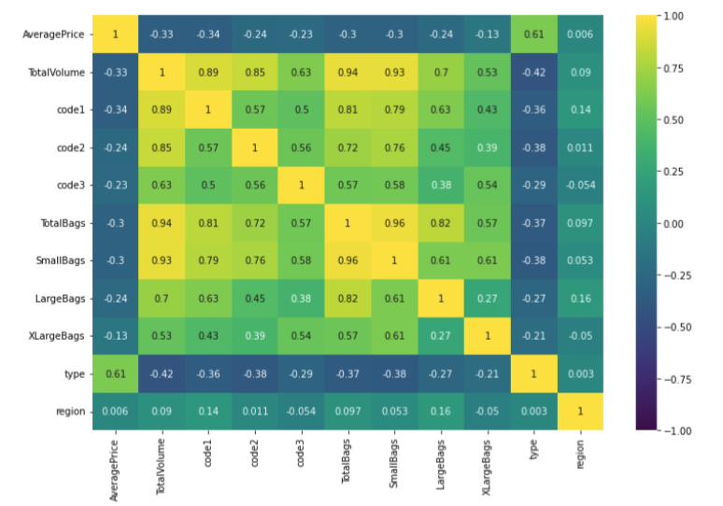
Feature correlation
Average Price and Total Volume are weakly correlated (correlation coefficient=-0.33)
Other features are also weakly correlated with average price, but mutually strongly correlated.
It does not seem that dropping any feature will help in predicting average price.
Notes:
The correlation is a measure of linear association, therefore we get low values for strongly nonlinear associations which can be captured by learning algorithms
We are using all independent variables at once in our. Model, so we can still have a better performance than using any of them separately.

Slide 9
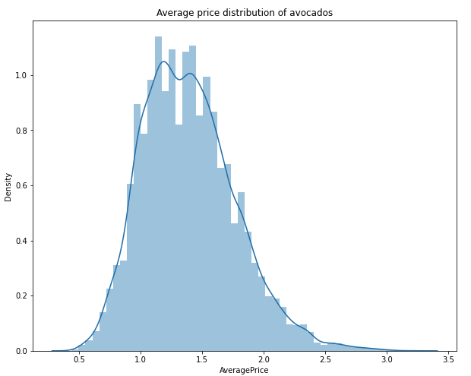
Data Visualization
AveragePrice is normally distributed
The values are concentrated approximately between 1.0 and 1.9

Slide 10
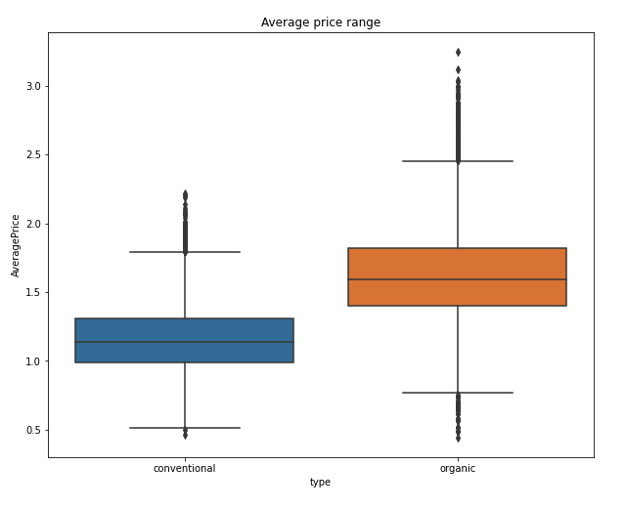
Visualize price by types of avocados
Average price range for organic and conventional avocadoes.
The organic avocados are more expensive than conventional avocados.
Avocados sold by category
Conventional count = 9167
Organic count = 9234

Slide 11
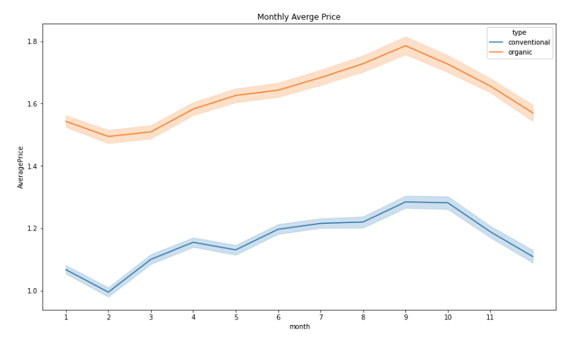
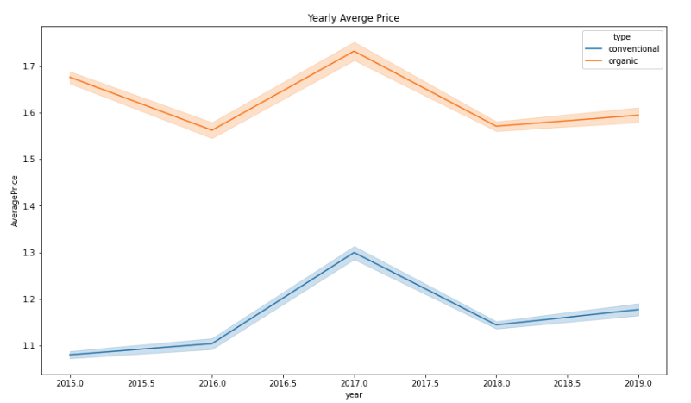
Monthly and Yearly Average Price by types of avocados
Monthly plot: Expensive during September and October while cheapest in the months of February.
From the yearly average price plot one can see that the year 2017 was the most expensive for the avocados.

Slide 12
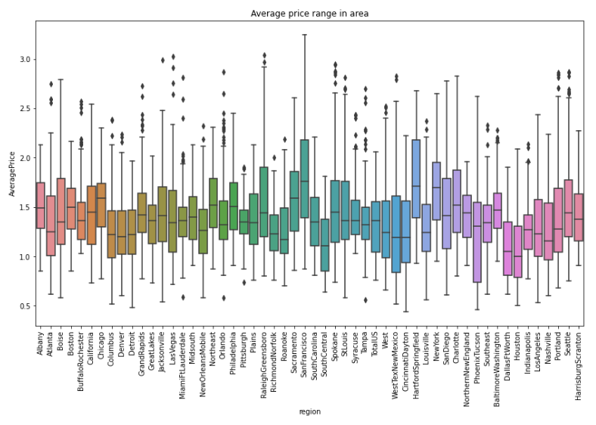
Top 5 most expensive regions in USA
HartfordSpringField
SanFrancisco
NewYork
Philadelphia
Sacramento
Findings:
SanFrancisco, Philadelphia and NewYork are bigger metropolitan cities, so the commodity price are always very high.
HartfordSpringField on this list is surprising. The higher prices may be due to high transportation costs from Mexico

Slide 13
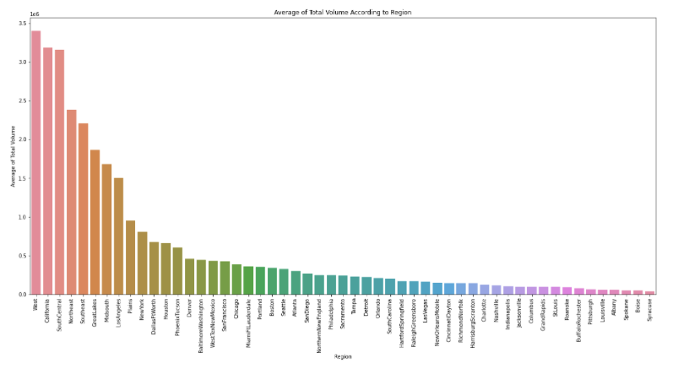
Top 5 avocado consumption regions
West
California
SouthCentral
Northeast
Southeast
I mix the bigger regions such as West, Northeast, Southeast and South Central with the city California.
Regions may contain multiple cities and therefore total volume consumption of cities cannot be compared with the region.
Region will always have large consumption relative to the cities.

Slide 14
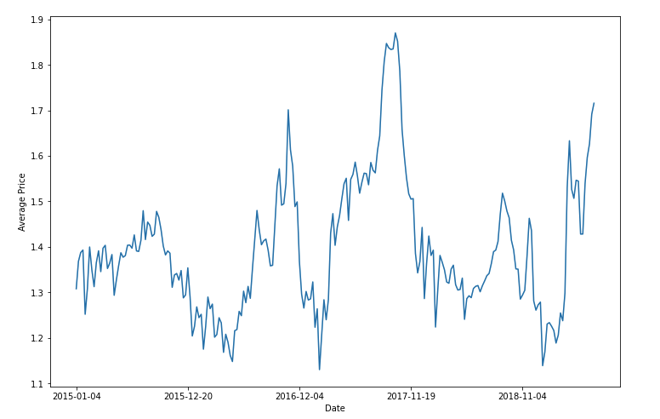
Average Price trend over the years
One can see that the yearly prices show some seasonal trend here. For example, in the month of February the prices are lowest and in the months of Sep-October the prices are high. There is a noticeable price peak in the year 2017

Slide 15
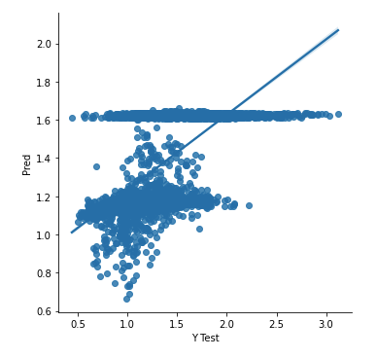
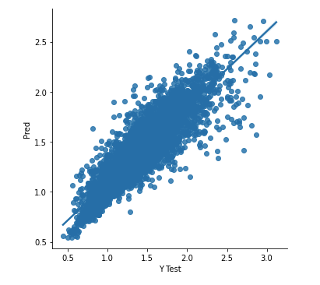
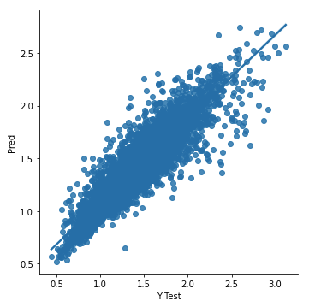
Machine Learning Predictive Models
Linear Regression (LR)
Random Forest Regression (RF)
Extra Trees Regression (ETR)
Model | RMSE | R2_score
LR | 0.29 | 0.4
RF | 0.18 | 0.77
ETR | 0.16 | 0.81
Notes:
I also tested XGBoost but not reported here. Performance was similar to Extra Trees Regressor.

Slide 16
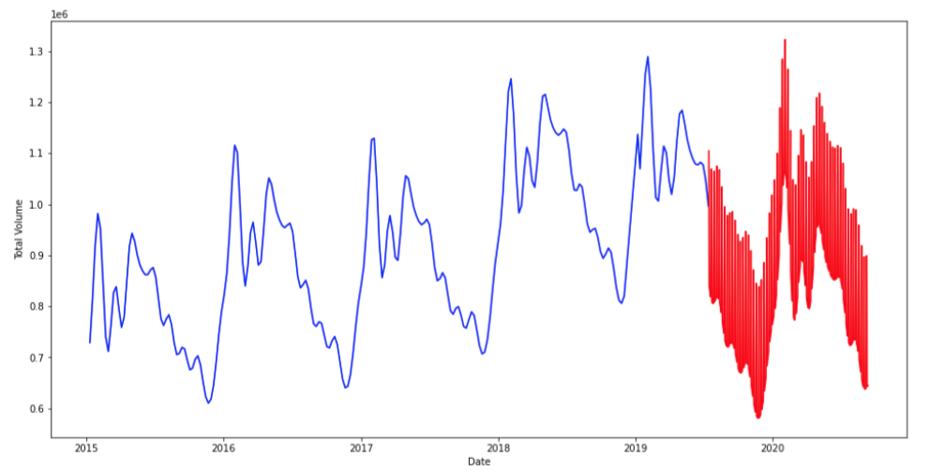
Time Series Analysis and Forecasting of TotalVolume
Total Volume forecasting using Facebook Prophet
The forecast follows the sesonal trend of the total volume and also shows that the total volume will go down and then will be up in the comming year.

Slide 17
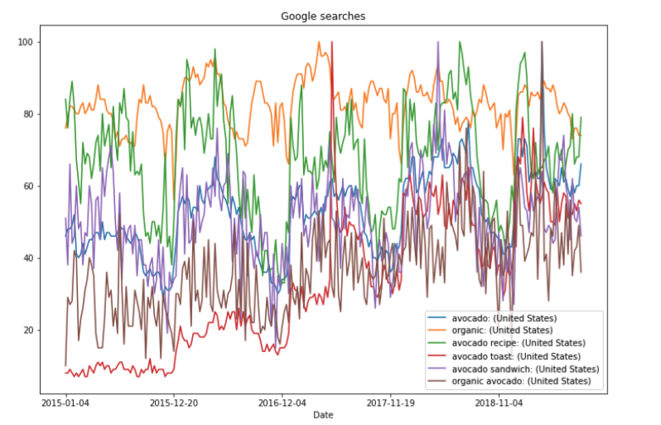
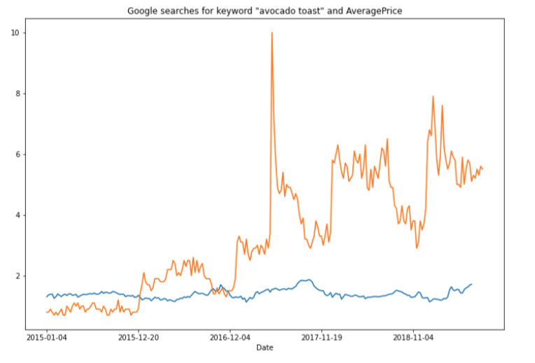
Google Search data
Average price is potted underneath the
Google search data of avocado toast.
Plot google keywords search data
Google search of toast and organic avocado keywords shows a significant rise over the years. The organic products have lately been more on demand. Maybe toast also became more popular in recent years! The other keywords data shows a yearly seasonal fluctuations.
I wanted to check whether the search data explains the average price fluctuations. It does not seem to do so.

Slide 18
Conclusion
EDA on the data helped in understanding overall data characteristics, correlation between features and distribution of different features.
Analysis shows that Average price of avocados follows a seasonal trend: Prices are low at the start of a year and high toward September and October. This relates to the avocados harvesting season in the US and can play an important role in profit making strategy for AvocadoKing.
The forecast follows the seasonal trend of the total volume and also shows that the total volume will go down in the coming year (2020) and then will be up. Price and volume forecasts can be used by AvocadoKing to make business plans for future.
The avocados are expensive in HartfordSpringField and SanFransico and West regions and the consumption is highest in California. This analysis will be helpful in logistics and import planning for the AvocadoKing.
Google search data have potential to complement and explain predictions made by machine learning models. In this task, however I did not find that the given google search data is helpful.
To make better forecasts on avocado price/volume, one can apply machine learning techniques, which is an interesting direction for data-driven predictive analysis, but with its own set of challenges.
Notes:
To make better forecasts on avocado price/volume, one can apply machine learning techniques, which is an interesting direction for data-driven predictive analysis, but with its own set of challenges.
Then I can discuss in the end during the presentation that due to time constraints I could not apply other statistical and machine learning forecasting techniques. However, that's the research area I have been working in my PhD, so I would be happy to discuss it here.

